Slide 1
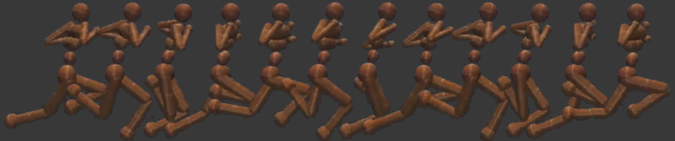
On the model-based stochastic value gradient for continuous reinforcement learning
Brandon Amos¹ Samuel Stanton² Denis Yarats^{1,2} Andrew Gordon Wilson²
¹Facebook AI Research ²NYU
L4DC 2021

Slide 2
Focus: Model-based methods for continuous control
Budding with methods and applications
But rife with problems Spoiler: We don’t solve these
E.g., objective mismatch, short-horizon bias, inaccurate models, accumulating errors
Policy
Neural Network(s)
State
Action
System Dynamics
Future Plan
(non-exhaustive)
Notes:
Our focus is on continuous control, which has promising applications in robotics and control
Solving continuous MDPs: Find a policy that maps from states to actions
Model-based policies have explicit dynamics/plans
Open problem for decades, challenging class of problems because of these issues

Slide 3

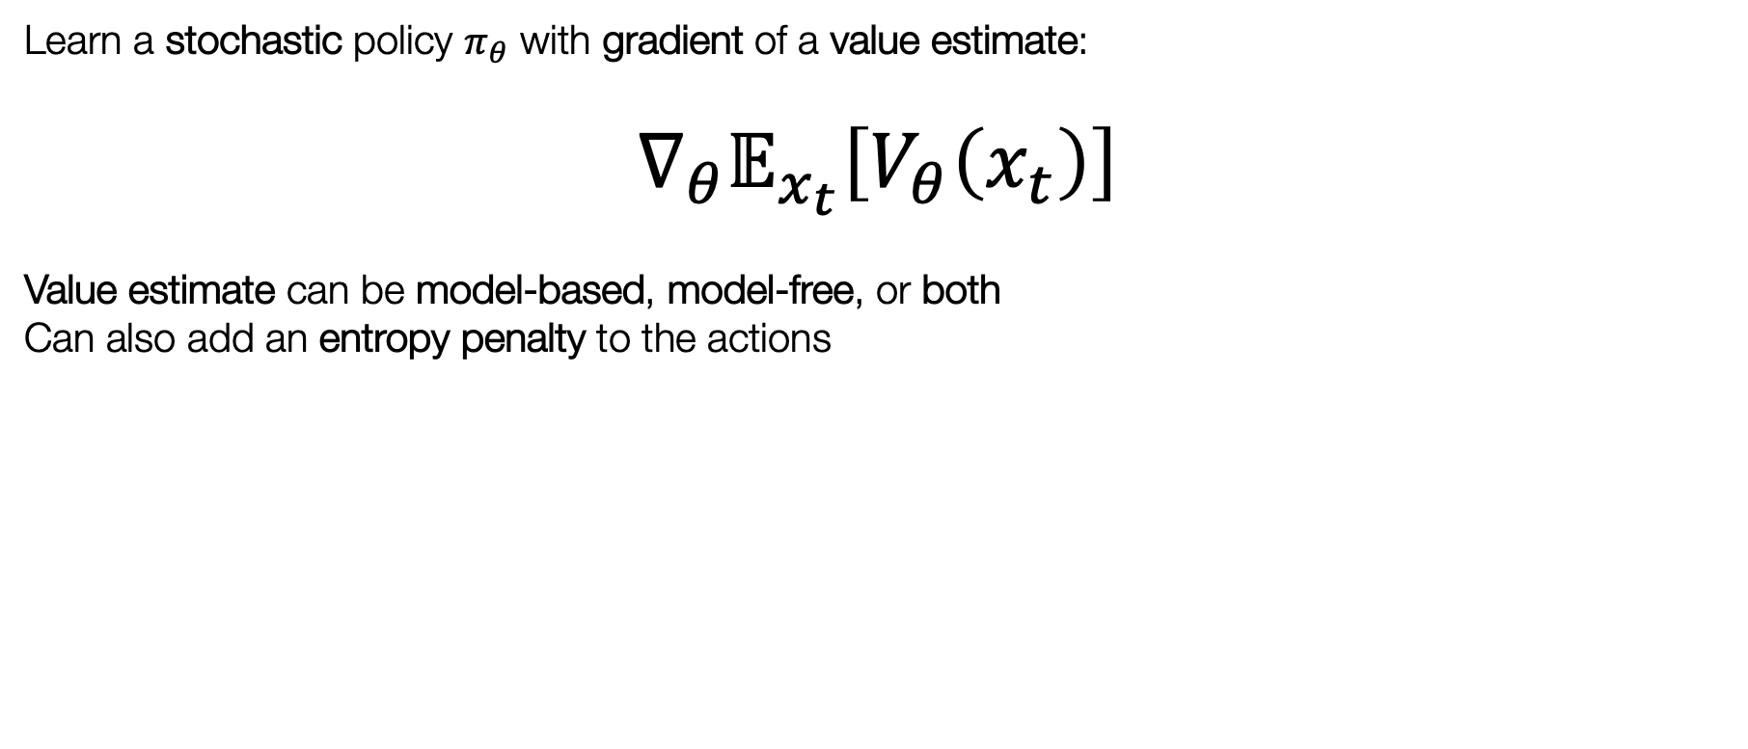
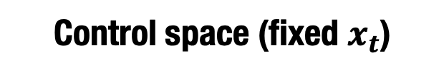


Background: The Stochastic Value Gradient
Heess et al. (NeurIPS 2015)
Learn a stochastic policy $π_{θ}$ with gradient of a value estimate:
$$∇_{θ}𝔼_{x_{t}}\left[V_{θ}\left(x_{t}\right)\right]$$
Value estimate can be model-based, model-free, or both
Can also add an entropy penalty to the actions
Parameter space
Control space (fixed $x_{t}$)
Notes:
The key piece of background we will use
Go read their paper! We just modernize it
SVG is a general class of methods popularized in Heess
Learn a reactive policy using gradients of some value estimate
Beauty: Generality of this class of methods: Model-based, model-free, entropy penalty
Perspective of amortized optimization, finds policy to maximize the value estimate in a single shot

Slide 4
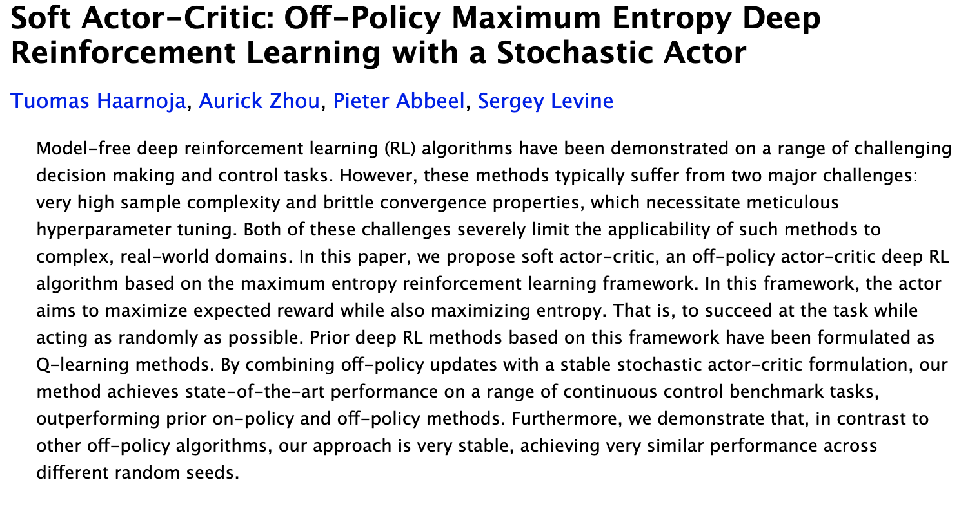
Background: The Soft Actor-Critic
Notes:
We won't review SAC in this talk
Model-free method for continuous control
Soft = Adds entropy penalty to the action space

Slide 5
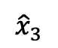
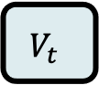
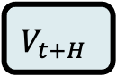
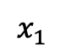
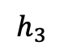
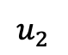
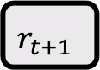
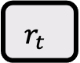
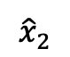
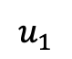
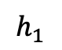
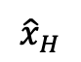
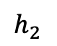
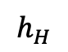
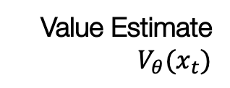
SAC-SVG(H): A model-based SAC extension
Observation (S4.1 of our paper). The soft actor-critic (SAC) policy update is just a value gradient with a model-free value estimate and entropy regularization
Idea: Replace SAC’s value estimate with a more accurate model-based expansion for H steps.
Also use a simple recurrent dynamics model (no ensembling)
trained for multi-step predictions
SAC-SVG(0): equivalent to SAC
Model-free value estimate
SAC-SVG(H) when H>0
Model-based value expansion with model-free estimate at the end
Value Estimate
$$V_{θ}(x_{t})$$
$$V_{t}$$
$$r_{t}$$
$$r_{t+1}$$
…
$$V_{t+H}$$
Policy update The stochastic value gradient $∇_{θ}𝔼_{x_{t}}\left[V_{θ}\left(x_{t}\right)\right]$
$${\hat{x}}_{2}$$
$${\hat{x}}_{3}$$
$${\hat{x}}_{H}$$
$$h_{1}$$
$$h_{2}$$
$$h_{3}$$
…
$$h_{H}$$
$$x_{1}$$
$$u_{1}$$
$$u_{2}$$
Notes:
Interesting insight: the model-free algorithm SAC’s policy update is just a stochastic value gradient
We consider a model-based extension of it called SAC-SVG(H)
On the left, when the horizon is zero, we capture SAC and the value estimate is the standard SAC value estimate.
On the right, when the horizon is >0, we perform a model-based value expansion.
Why do this? Model-based value expansion can be more accurate and adapt better to the most recent policy than a model-free estimate
Caveat: Can’t do this for too long or the model becomes inaccurate
Also introduces the problem of needing to learn the dynamics from the system, we use a simple LSTM
Emphasize simplicity of the dx

Slide 6
SAC-SVG excels in locomotion tasks
Evaluation Rewards
Notes:
Data-limited locomotion tasks from POPLIN
Short horizon (even just 2!) works well

Slide 7
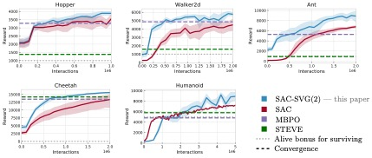
SAC-SVG excels in locomotion tasks
Notes:
Locomotion tasks from the MBPO paper

Slide 8
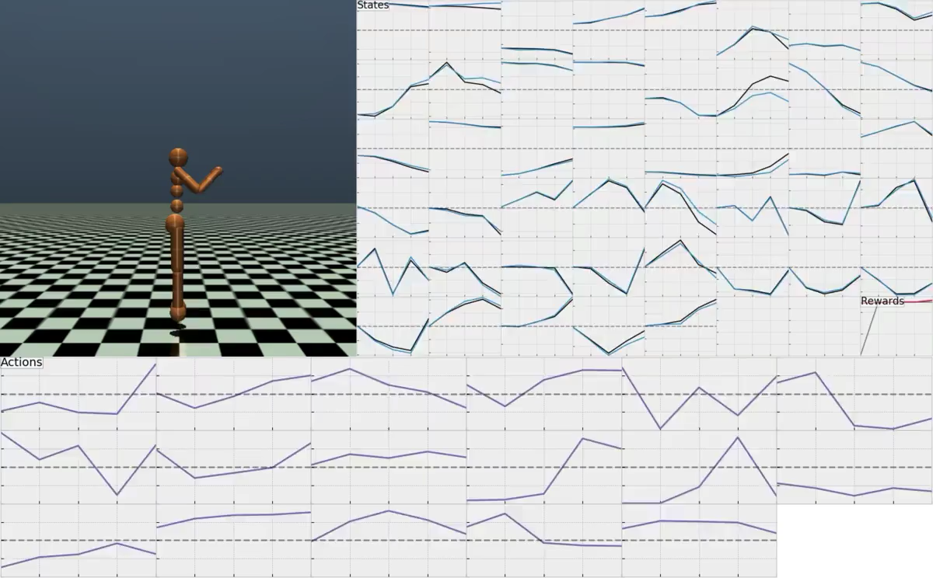

Slide 9
Discussion
Is epistemic uncertainty important for exploration in Mujoco environments? A target action entropy schedule worked well for us
Should the value expansion be used for actor and/or critic updates? We found actor updates to be the best
Model becomes inaccurate quickly Short horizons work best for us (and MBPO)
Benchmarks and baselines are challenging to do properly E.g., from papers tweaking environments or not re-tuning parameters
Notes:
We don't solve model-based RL

Slide 10
Concluding remarks
The stochastic value gradient is competitive with short-horizon model rollouts and action entropy
We attain these results with a simple deterministic LSTM for the world model
Key future directions include:
Refinement or semi-amortization
Constrained MDPs
Model-based extensions of other model-free algorithms
More sophisticated world models, e.g., self-supervised
Going beyond the single-agent, single-task setting

Slide 11



On the model-based stochastic value gradient for continuous reinforcement learning
Brandon Amos¹ Samuel Stanton² Denis Yarats^{1,2} Andrew Gordon Wilson²
¹Facebook AI Research ²NYU
L4DC 2021
github.com/facebookresearch/svg
brandondamos samscub denisyarats andrewgwils
bamos.github.io samuelstanton.github.io cs.nyu.edu/~dy1042 cims.nyu.edu/~andrewgw

